Slide 1

Admin Script Hoarder to
PowerShell Developer
Notes:
• Introduction
This session will take you through the lifecycle of turning your hoarded scripts
from the scratch folder of your laptop, into reusable functions and modules
that you can share with your colleagues.
If we have time we will then look at how you can develop your module to share it with the world 👍

Slide 2






About Me
 | Live Services Specialist @ Sage
 | 4(ish) Years PowerShell Trial & Error
 | @BrettMiller_IT
 | https://github.com/brettmillerb
 | https://millerb.co.uk
Notes:
• Ops Background now in a more DevOps focused role
• Working largely with Azure & AWS
• 12k databases
• 600+ IaaS vm’s
• Mixture of PaaS/IaaS more serverless
OSS Contributions
Twitch Streaming 👍

Slide 3
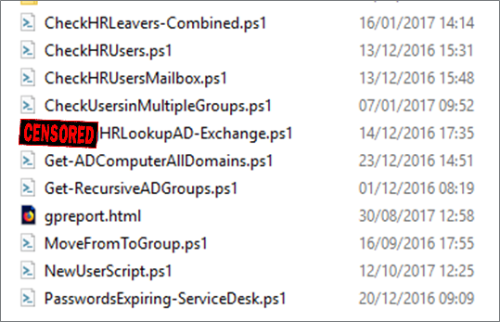
Admin Script Hoarder
Scripts stored locally or in a fileshare😕
Only me that uses them so 🤷‍♂️
No error handling ❌
Hardcoded variables/secrets 😲
No backups 🤦‍♀️
No access control 😱
No way of sharing scripts 🤮
Notes:
• ACTUAL SCREENSHOT
Like many folks not used to writing scripts I was haphazard at best
Copy and pasting from StackOverflow
Not fully understanding what scripts were doing
Generally running in production
Mixed Results

Slide 4
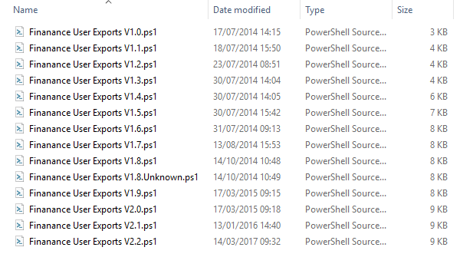
Admin Script Hoarder
This look familiar?
Notes:
Aaaah version control

Slide 5
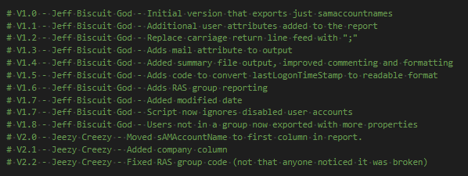
Admin Script Hoarder
What about this?

Slide 6
Sharing is Caring
Sharing code makes you think about:
Error Handling
Consistency
Performance
Compatibility
Usability
Security
Notes:
Error Handling:
• Does your code throw useful errors
• Does it throw errors correctly terminating vs non-terminating
Consistency:
• Does it behave how someone expected
• Does it behave the same way as other code
Performance:
• Does your code run in a timely manner
• Is it performant enough?
• Do you care if it takes a long time if it’s scheduled to run over night
Compatibility:
• Is it Cross Platform (MacOS, Linux, Windows, ARM devices)
• Will it support pipeline support e.g. Get-Something | Set-Something
Usability:
• Does it have Comment Based Help
• Is the help discoverable
• Are the Parameters named sensibly
Security:
• Is your code doing anything sketchy
- Setting TLS settings
- Setting Registry Keys to bypass security controls
• Are there any dependencies?

Slide 7
PowerShell Code
Should be in Source Control
Consistency is key
Pick a style, stick to it
Delivering Value
Should have unit tests
“Developers who write unit tests write more testable code”
- Nicole Forsgren
Notes:
Source Control:
• It will save your life
• Allows greater and easier collaboration
• It’s FREE!
Consistency:
• Brace styles
• Outputting Objects
• Filter Left | Format Right
• Single Responsibility Code
Delivering Value:
• Don’t re-design the wheel
• Is what you’re doing beneficial
Unit Testing:
• Unit Testing = Immediate Feedback
• Helps you write better code
• Identify failures before your users do

Slide 8
Your First Module
Copied from a blog post
Most Likely Warren Frame’s
No idea what it’s doing or why
Lots of issues exporting functions correctly
So infrequently you forgot what you did for next time
Failed to Import after all of the above
Notes:
• Didn’t really know what you were doing
• Blindly followed some blog posts (most likely Warren Frame’s)
• Module imports but the functions don’t work
• Module doesn’t import, don’t know why

Slide 9
Building PowerShell Modules
Demo

Slide 10
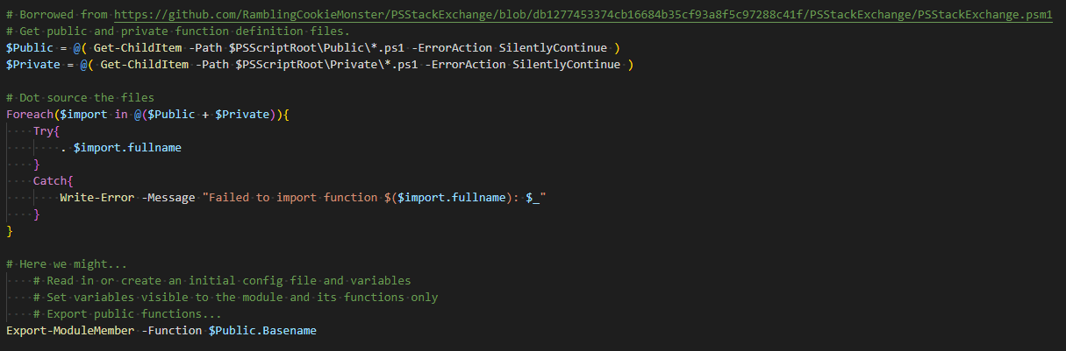
Building PowerShell Modules
Dot Source all of the things!!!
Probably just stolen from someone's blog, it works…..we have no idea why but it does.
Notes:
• A module is effectively a way of importing code into your current session so that you can utilise it in your current context
• Much like you would in c# with using statements or gems in ruby etc etc

Slide 11
Building PowerShell Modules
Demo

Slide 12

Thank You ☺
 | aka.ms/psslack || aka.ms/psdiscord
 | slofile.com/slack/get-psuguk
 | @BrettMiller_IT
 | https://github.com/brettmillerb
 | https://millerb.co.uk

